Slide 1
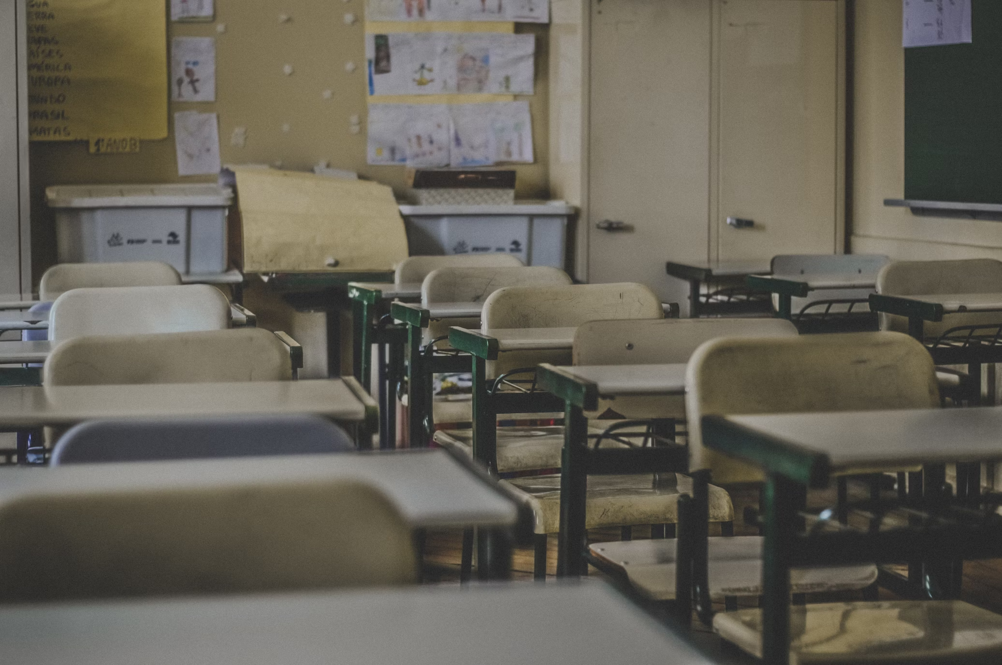
校園故事
Notes:
https://unsplash.com/photos/photography-of-school-room-hes6nUC1MVc

Slide 2
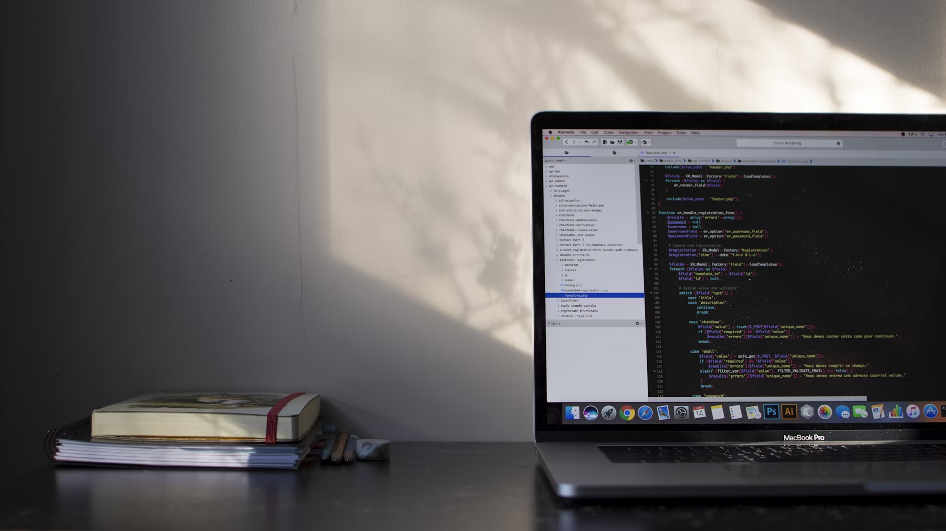
1. 目標
Notes:
https://unsplash.com/photos/macbook-pro-showing-programming-language-xrVDYZRGdw4

Slide 3
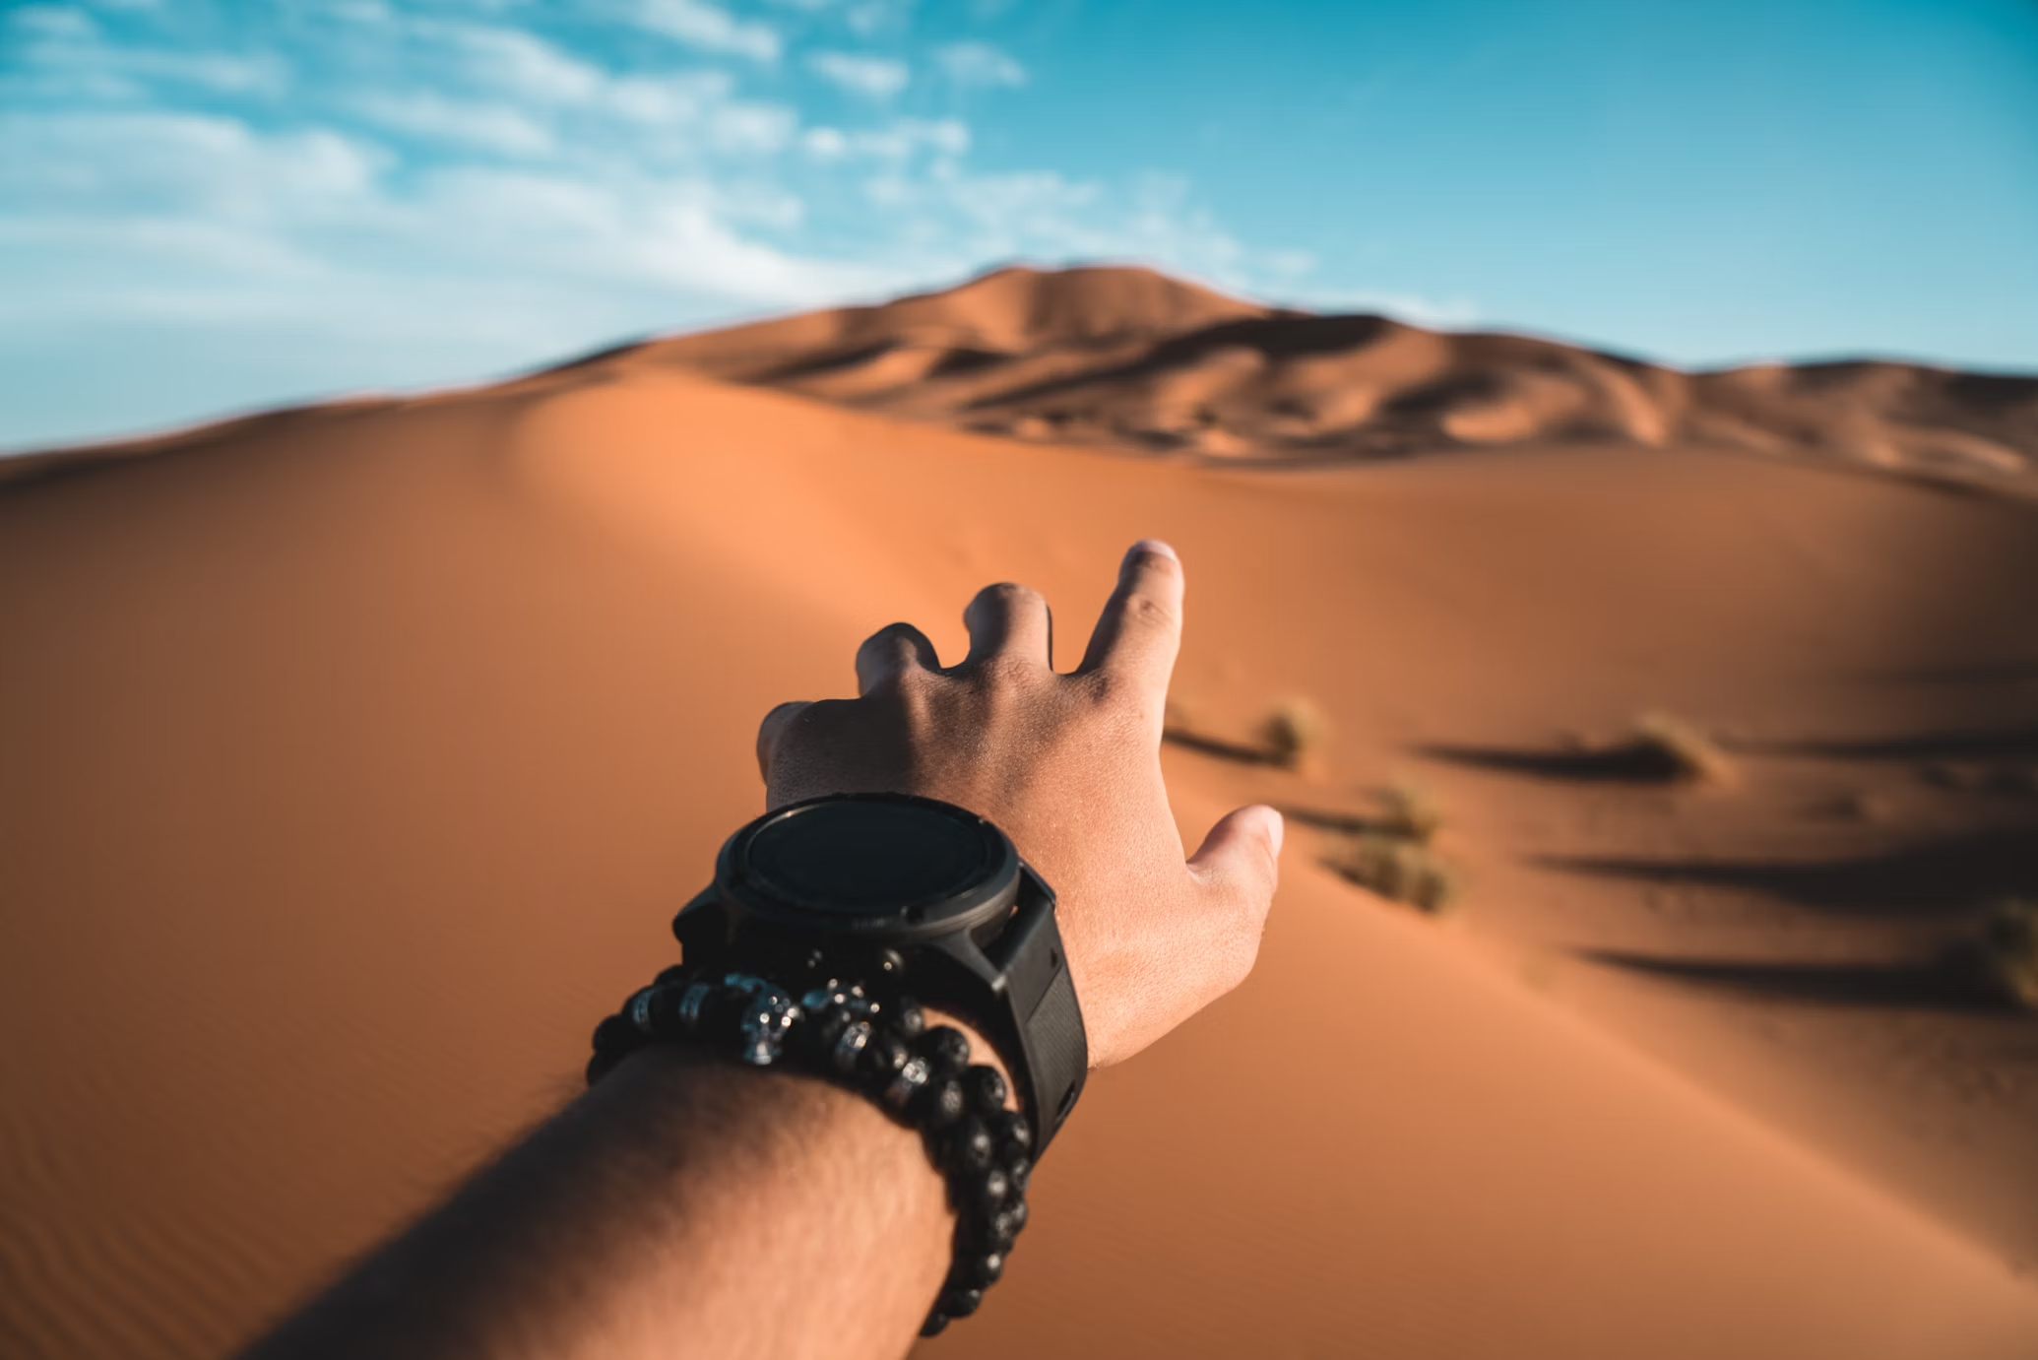
2. 阻礙
Notes:
https://unsplash.com/photos/person-pointing-to-dessert-dune-during-daytime-lGe2WE9TTOU

Slide 4
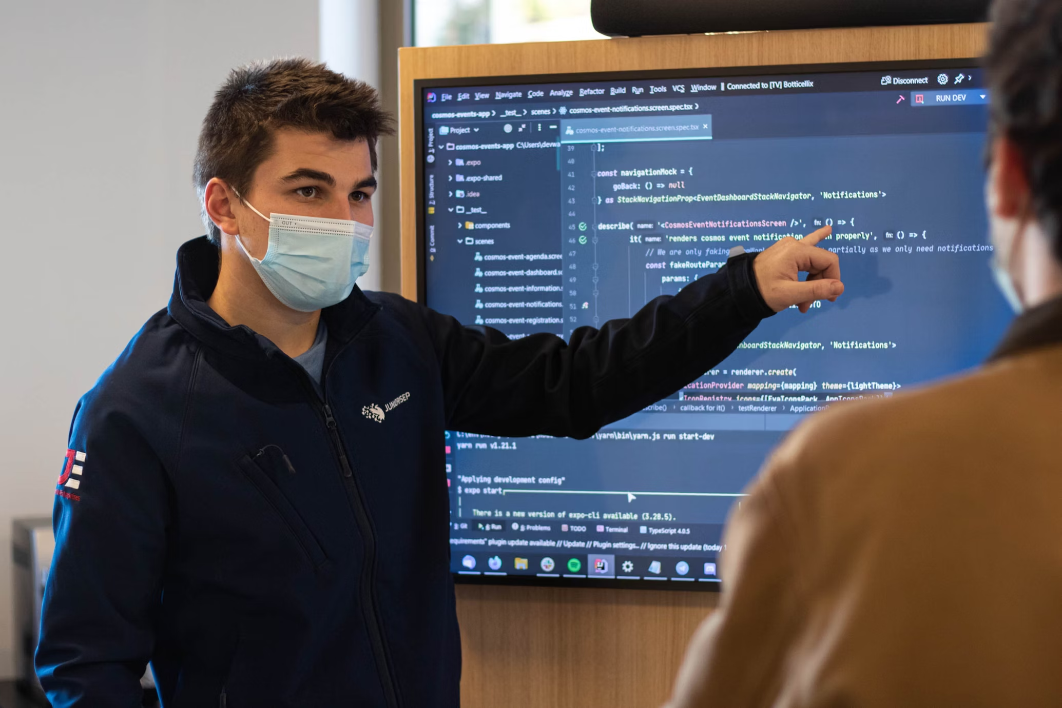
3. 努力
Notes:
https://unsplash.com/photos/man-in-black-jacket-wearing-white-face-mask-IBKyH0V3rew

Slide 5
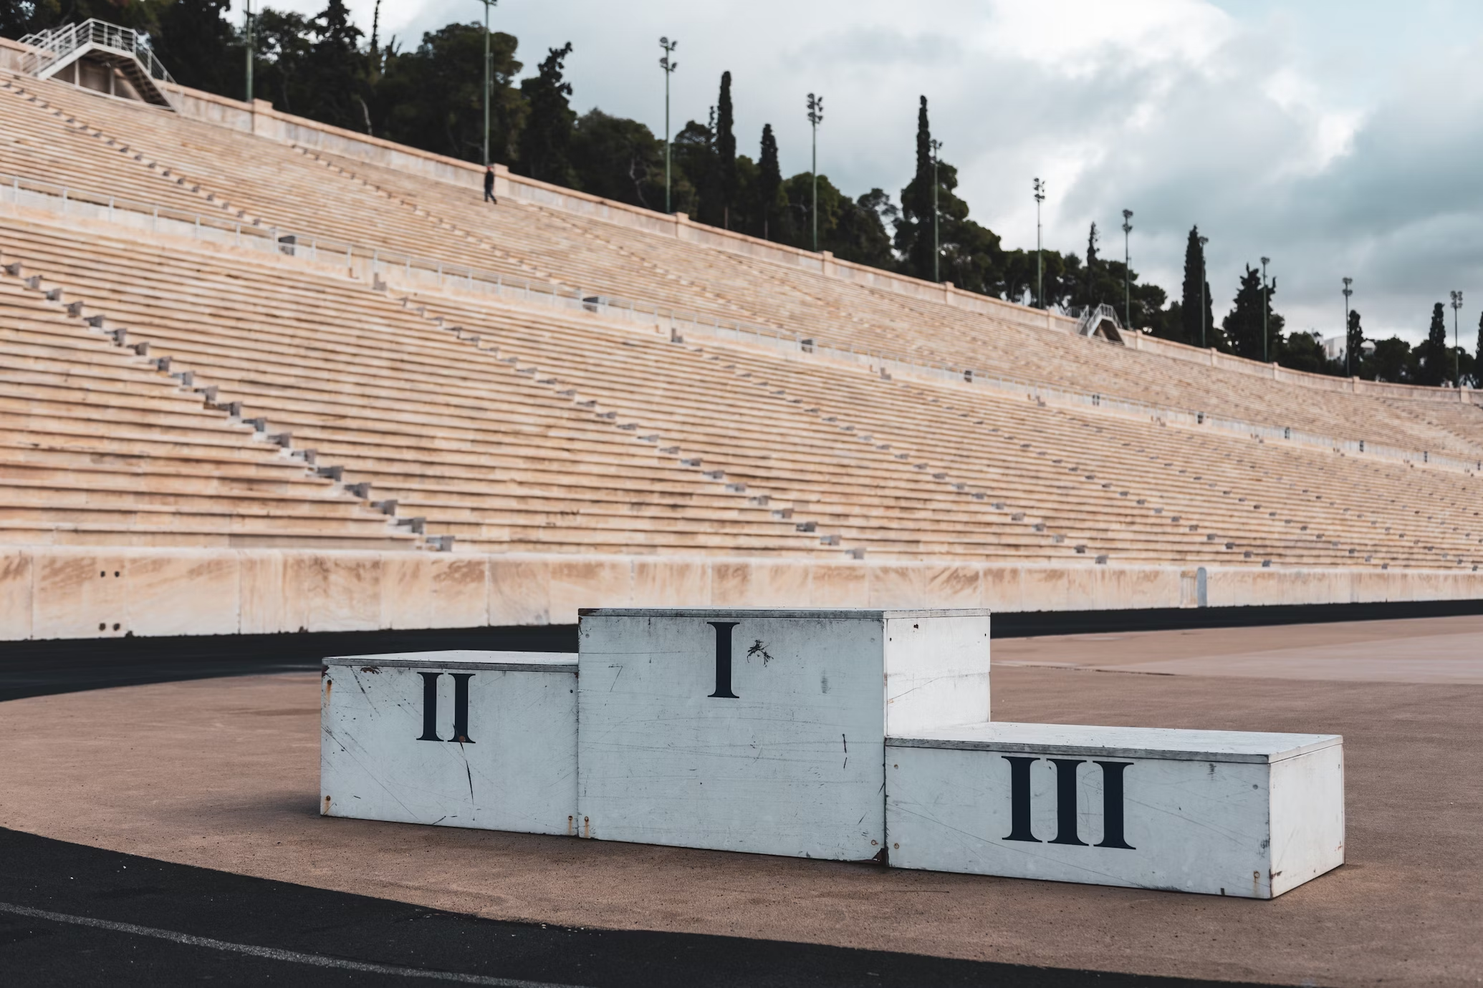
4. 結果
Notes:
https://unsplash.com/photos/white-and-brown-concrete-house-fbCtFV3FkfE

Slide 6
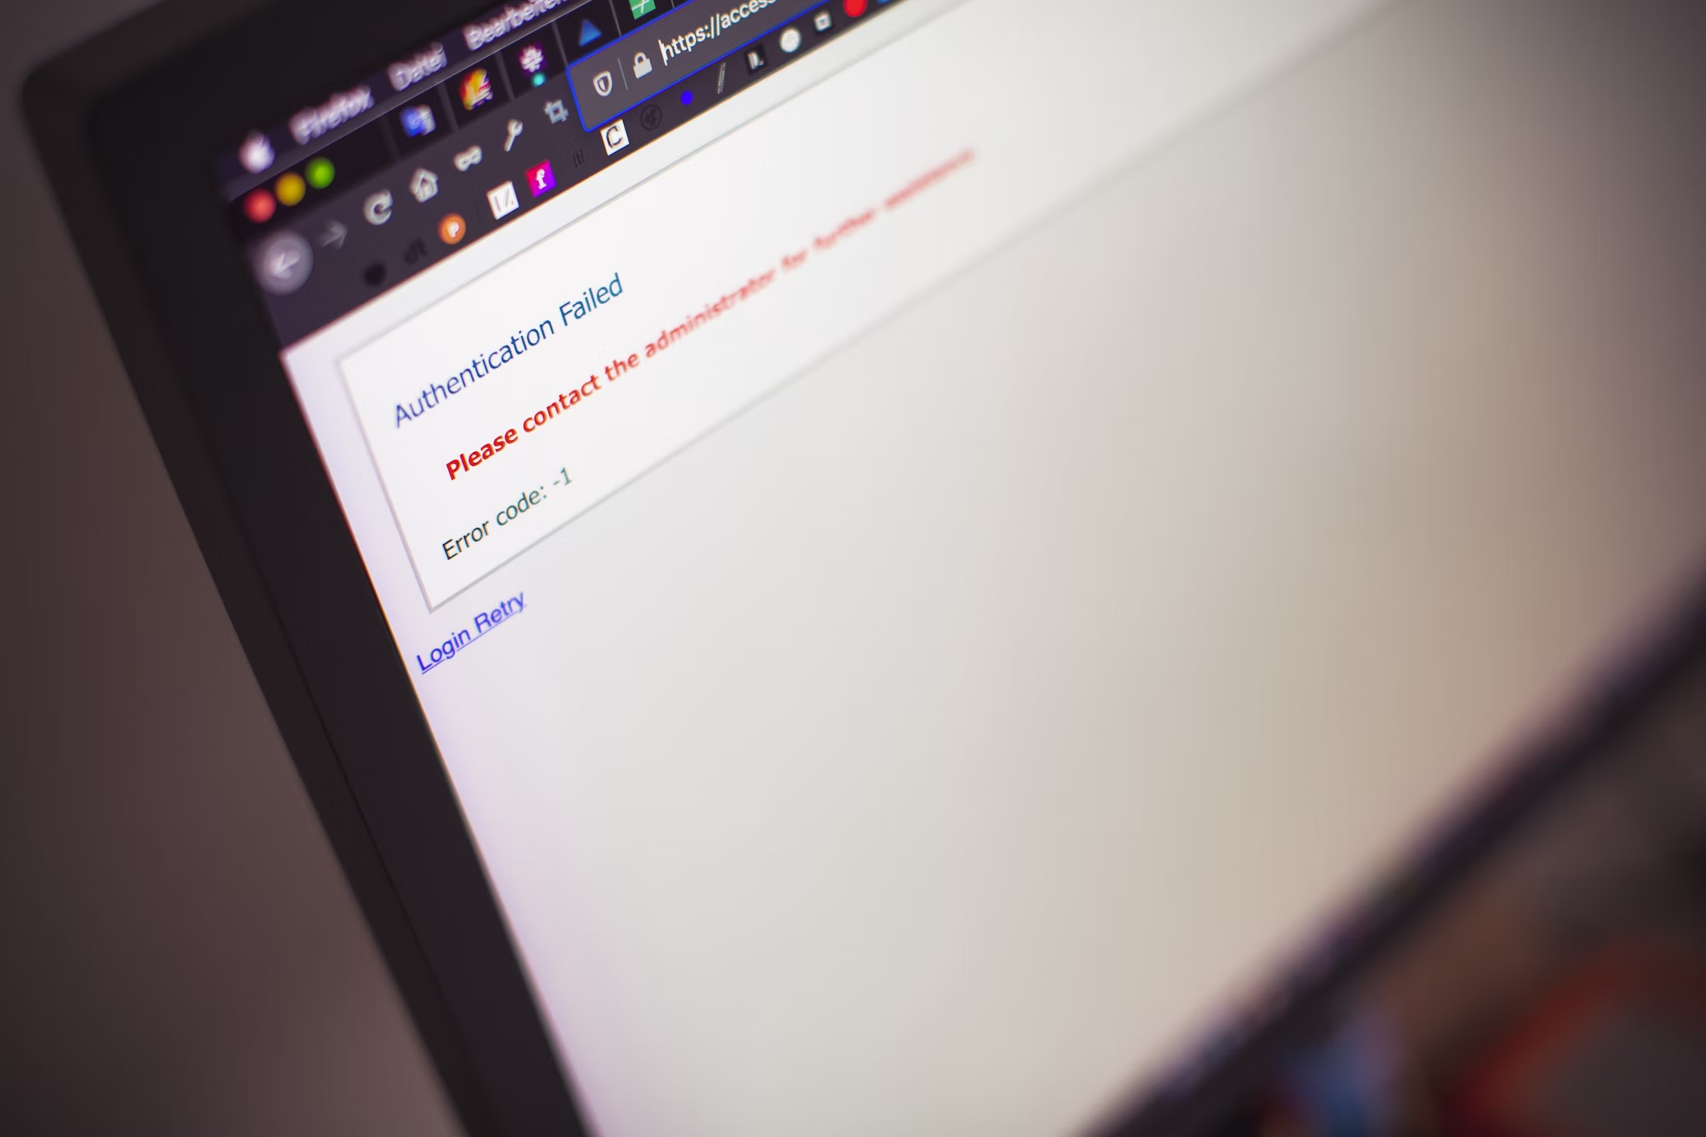
5. 意外
Notes:
https://unsplash.com/photos/black-flat-screen-computer-monitor-bMvuh0YQQ68

Slide 7
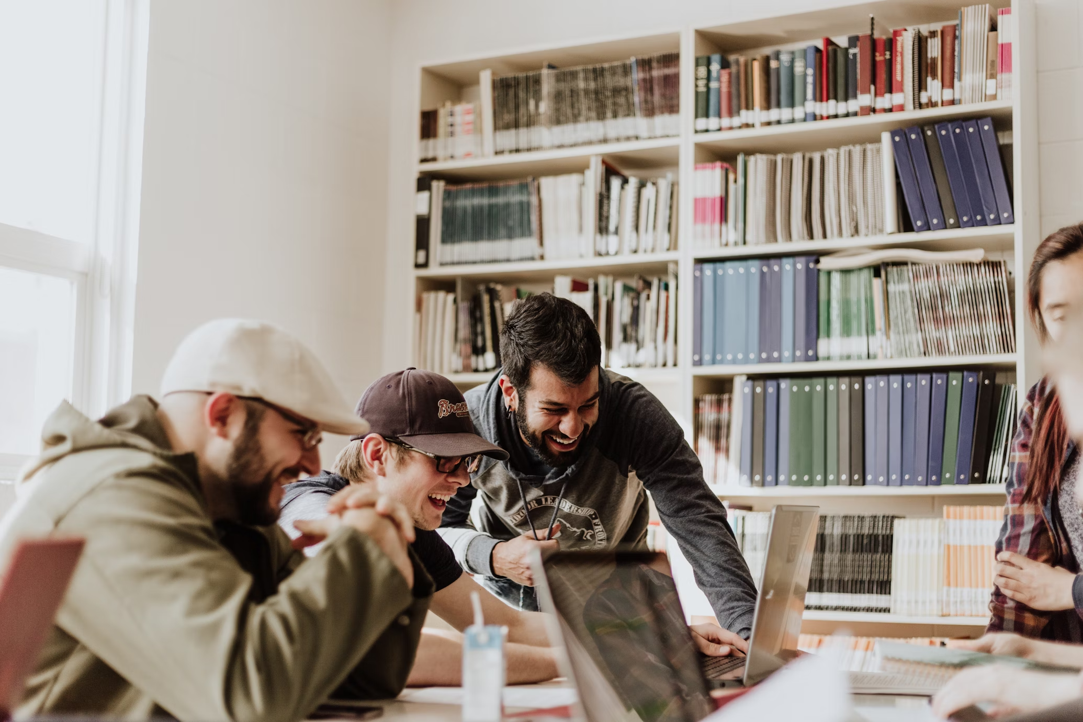
6. 轉彎
Notes:
https://unsplash.com/photos/three-men-laughing-while-looking-in-the-laptop-inside-room-XkKCui44iM0

Slide 8
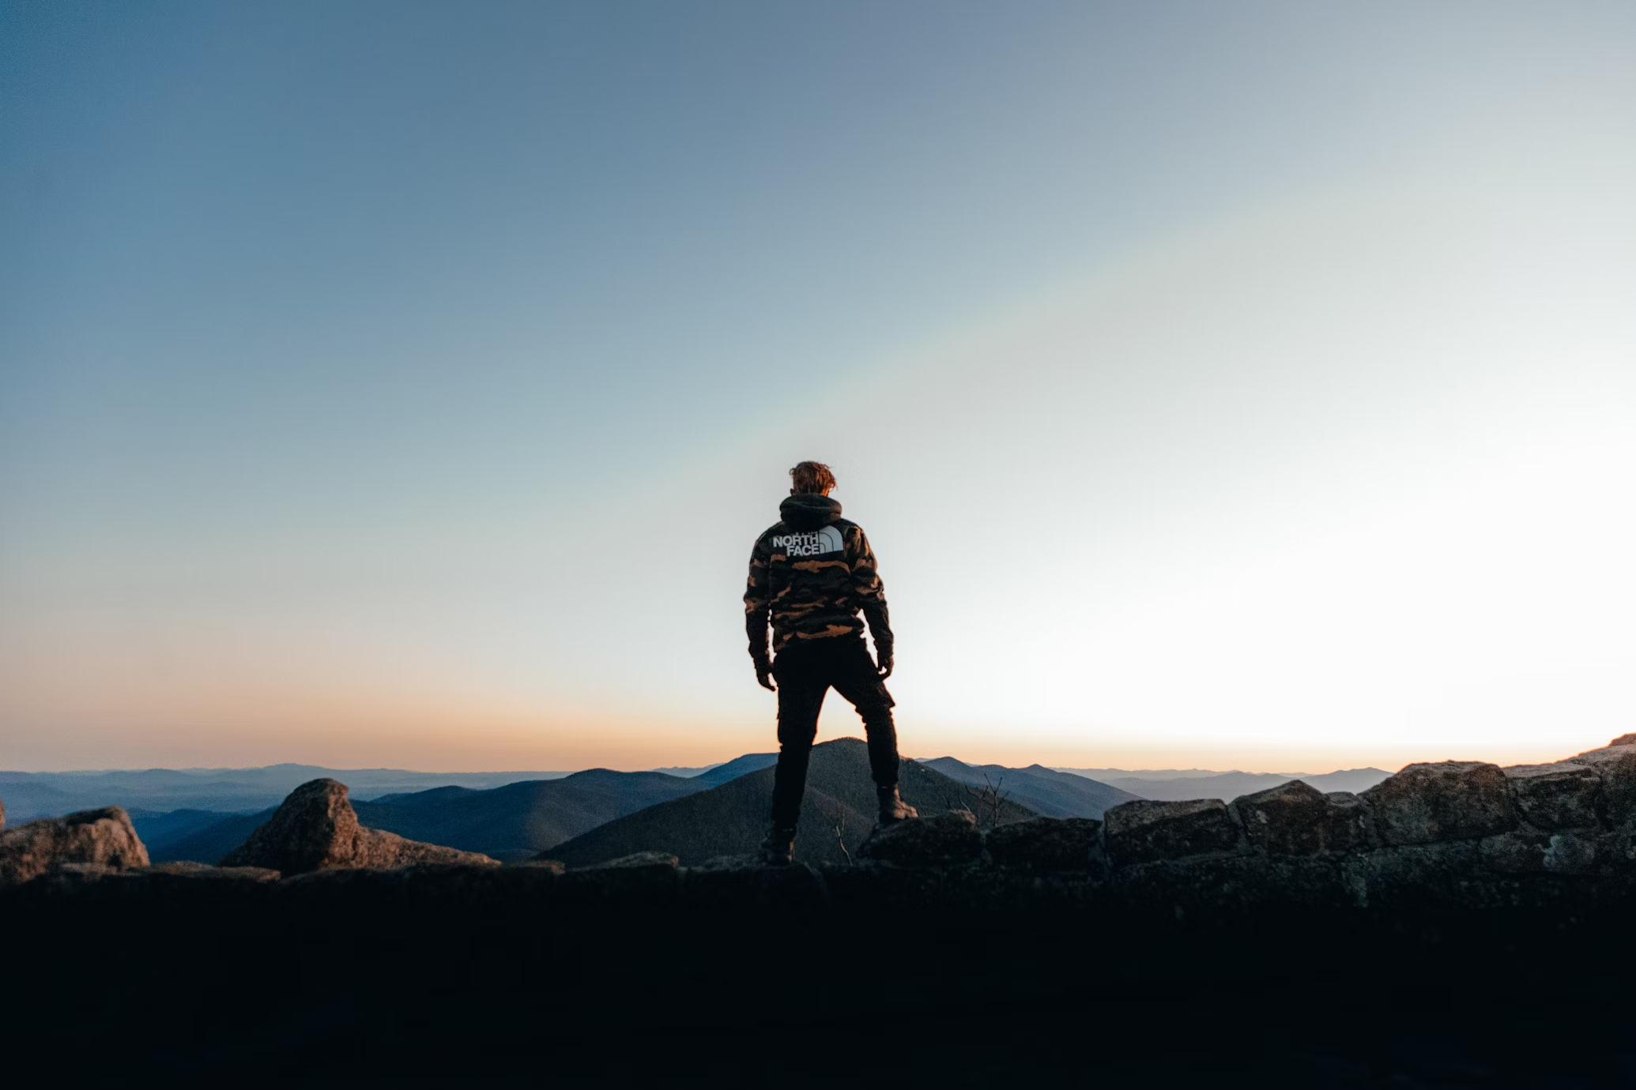
7. 結局
Notes:
https://unsplash.com/photos/man-in-black-jacket-standing-on-top-of-mountain-during-daytime-FQ-sW8mA94E

